Slide 1

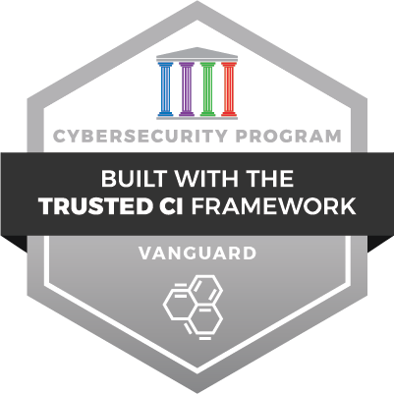
Things to know
when using FABRIC
for the first time

Slide 2
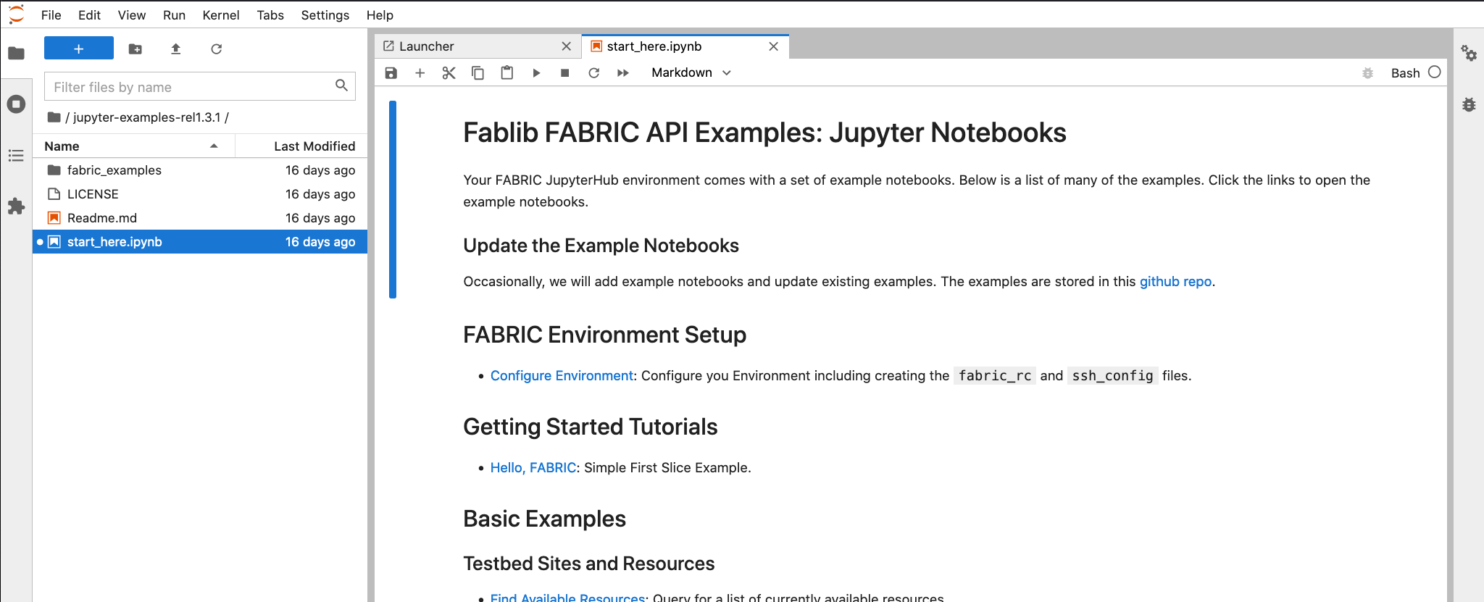
Basic Facts
FABRIC has three ways to interact with it:
Portal - focus on creating small topologies
Jupyter Hub notebooks via API - don’t just create topologies - run experiments
API libraries from your laptop/desktop
We recommend the notebooks as a starting point
Everything continues to be in active development
We keep adding infrastructure
We keep improving all of the software
Infrastructure is updated as it becomes available
Generally non-disruptive
Software updates are on a 3-4 month cadence between releases
Backward compatibility is not always assured, but we try

Slide 3

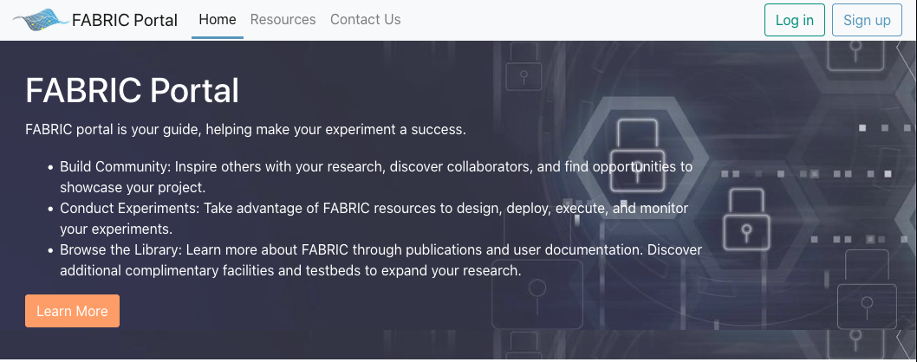
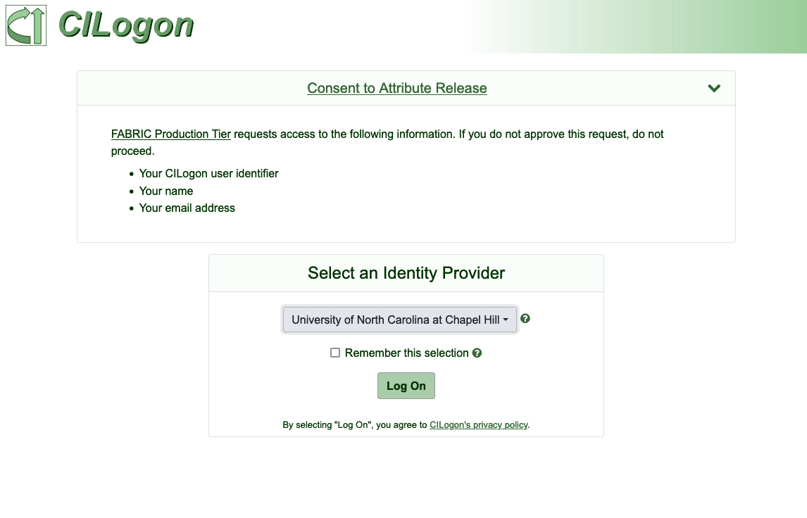
Getting in
Everything is tied to your institutional identity - Portal, Jupyter Hub, the use of APIs via CI Logon
We do allow Google IDs, but prefer you use your institutional login
GitHub ID is possible by prior discussion
Do NOT use ORCID (it is usually the first on the list)
Before you can do anything you must enroll via the portal
Click the ‘Sign Up’ link on the portal
Follow the workflow (confirm your email)
All signups are currently manually approved
Do not sign up using multiple identities
After you complete the enrollment, you can login to the portal
Next step: Projects

Slide 4
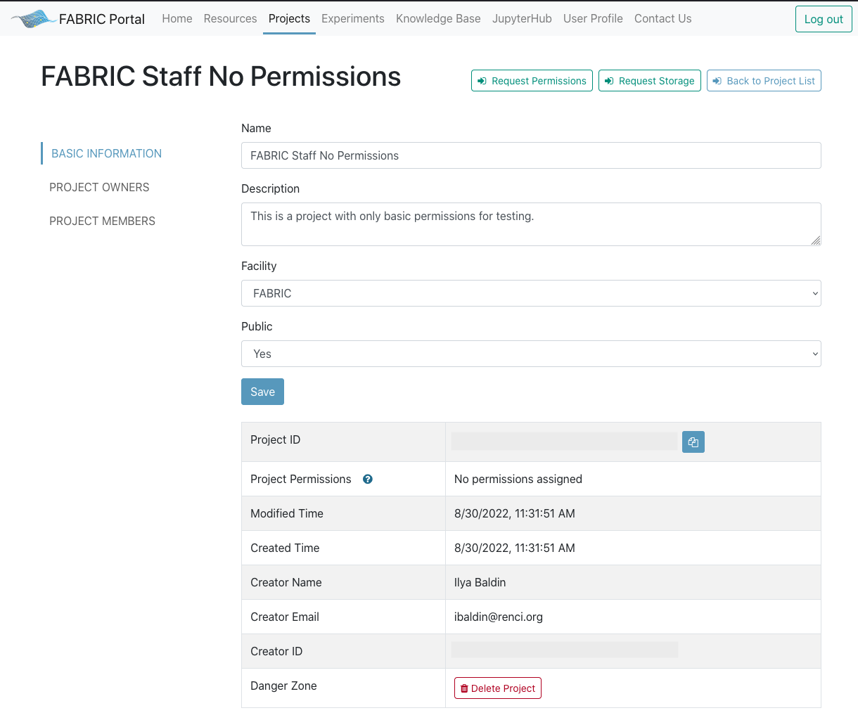
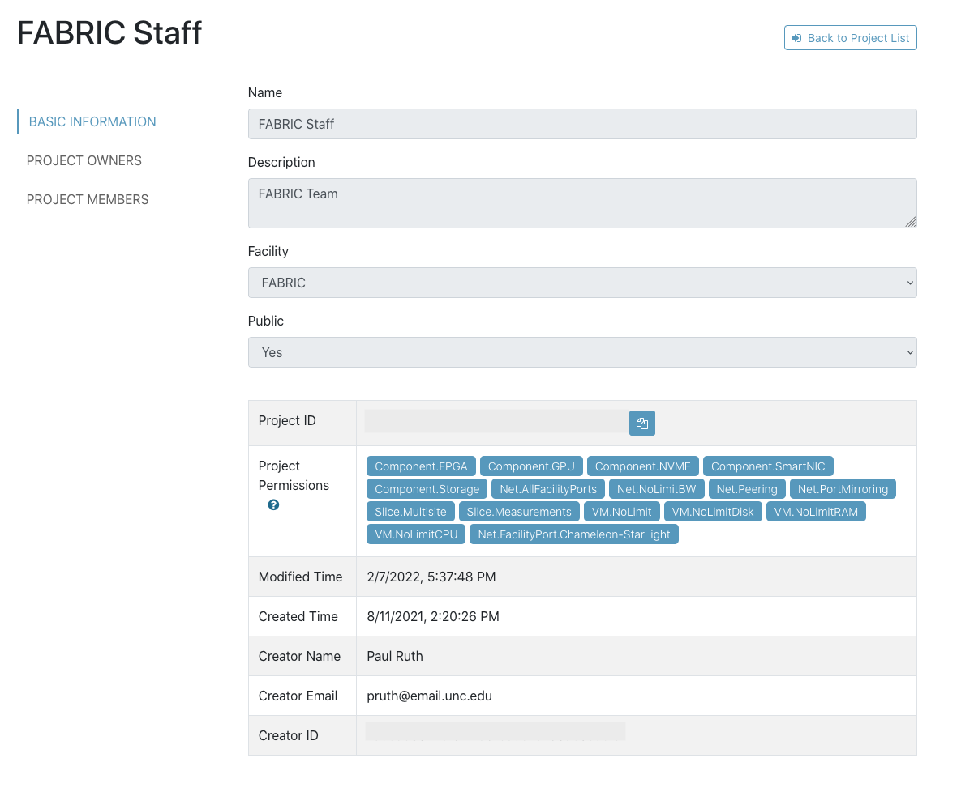
Using/managing Projects
A Project is a group of experimenters with the same permissions
Projects can only be created by a Project Lead
Project Lead who created the project can add Project Owners
Project Owners can add/remove Project Members
Each project has a set of permissions to specific FABRIC capabilities - specific components, networking capabilities etc.
When first created members of a project can only create small VMs in a single site
Everything else requires requesting additional project permissions via Portal by Project Owner
Next: Becoming a Project Lead

Slide 5
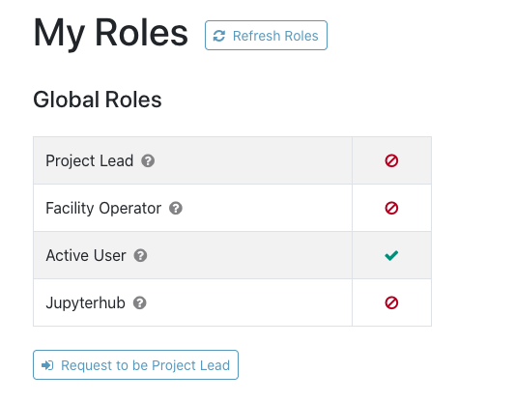
Becoming a Project Lead
Project Lead is an important role - reserved for faculty/senior staff at educational and research institutions
You can request the Project Lead role from the portal under ‘User Profile | My Roles’ section
Project Leads and Project Owners are responsible for the conduct of the experimenters they add to their project
Please familiarize yourself with AUP and Project Lead policies available in the FABRIC Knowledge Base
Next: Logging into VMs

Slide 6
Interacting with FABRIC
REST-based APIs and a Python library (FABlib) on top to make your experiments easier to run
FABRIC does not use SSL certificates - instead it uses short-lived API tokens (1hr) that can be refreshed
There is a Credential Manager service (API and UI front end) to help do that - it requires you to login using your institutional credentials to generate a token
Jupyter Notebooks do this automatically - get a new token and refresh as needed
There is an equivalent of ‘RSpec’ for topology descriptions based on property graph abstraction, serializable to GraphML and JSON.
You can save your topology description
Not meant to be human editable - manipulate it using API or Portal
Portal does not yet allow you to download topology description, this feature is coming.
Topology != Experiment
Our goal is to make Jupyter Notebooks your reproducible and shareable experiment profile
Build a topology (even across multiple testbeds!)
Configure it
Run the experiment
Annotate
Display plots and graphs
Share and let others reproduce your results
All from the comfort of your browser!

Slide 7
Logging into VMs
Once you are a member of a project you can create slices and login to VMs
FABRIC utilizes bastion hosts to safeguard access. What this means:
You cannot login to your VMs directly, you must go through the bastion host
You cannot login to the bastion host - only ‘hop’ over it using SSH commands
Two SSH keypairs are used:
Bastion - managed only through the portal, expires after 6 months. Automatically uploaded to bastion hosts and automatically removed.
Sliver/slice - can be managed through the portal, doesn’t have to be. Portal expires them after 2 years.
FABRIC never keeps private keys. If you lose a private key you have to generate a new keypair. You can have up to 10 keypairs of each type in the portal
Special SSH configuration file required for client to use the bastion hosts
Jupyter notebooks help set it up and show you how.
Next: Getting Help

Slide 8
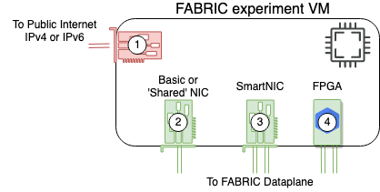
Management vs Dataplane
Each FABRIC VM has a management interface
Has a public IPv4 or IPv6 (more often IPv6) address belonging to hosting campus/facility
There are articles in our Knowledge Base to help figure out the best way to bridge IPv6/IPv4 divide
The management interface is intended only for
SSHing into the VM
Installing software into VM from public Internet
Limited bandwidth
Traffic filter rules prevent hosting Internet-facing services
Optionally one or more high-bandwidth dataplane interfaces belonging to different types of NICs
Use those to connect VMs in a slice into topologies
Connect to public Internet on-demand
IP addresses come out of FABRIC ASN allocation

Slide 9
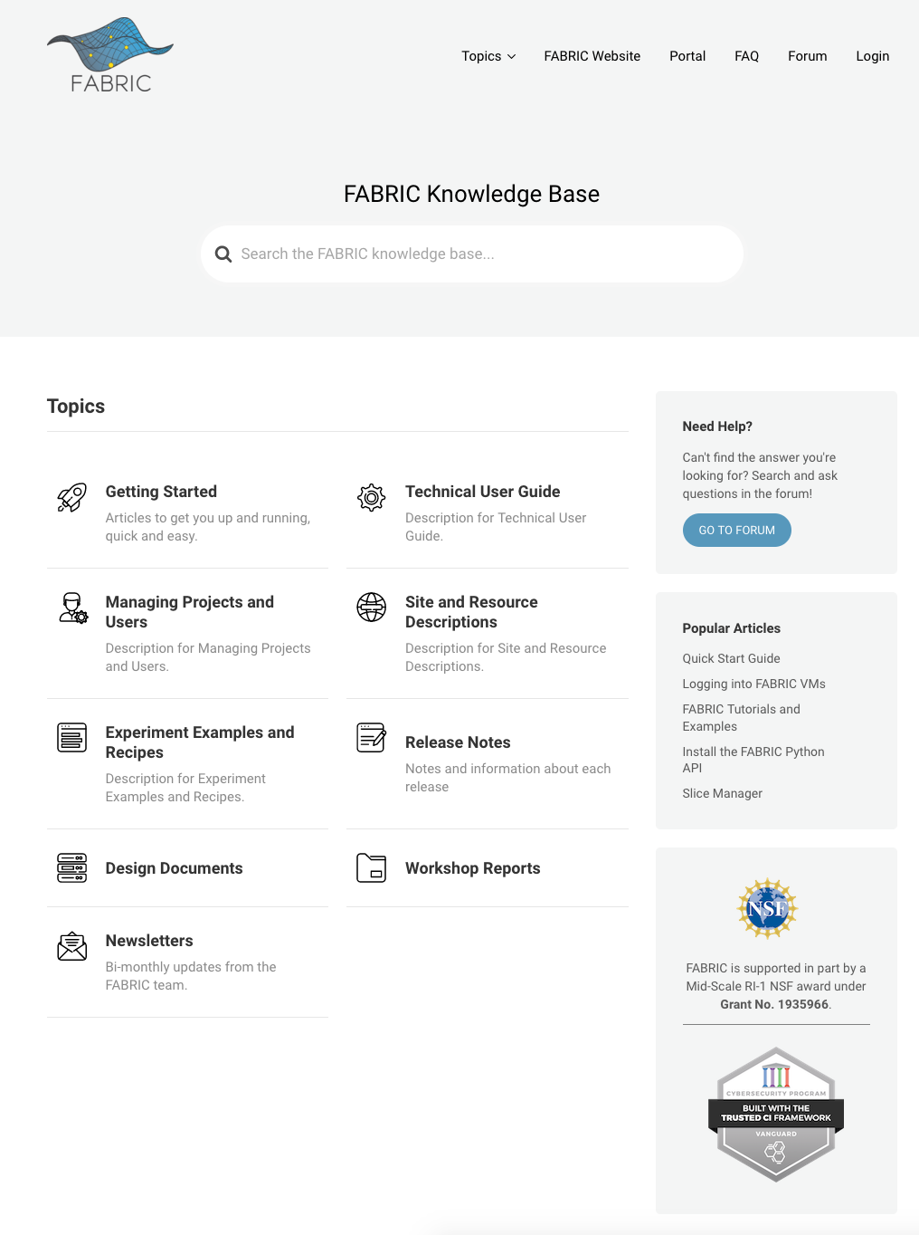
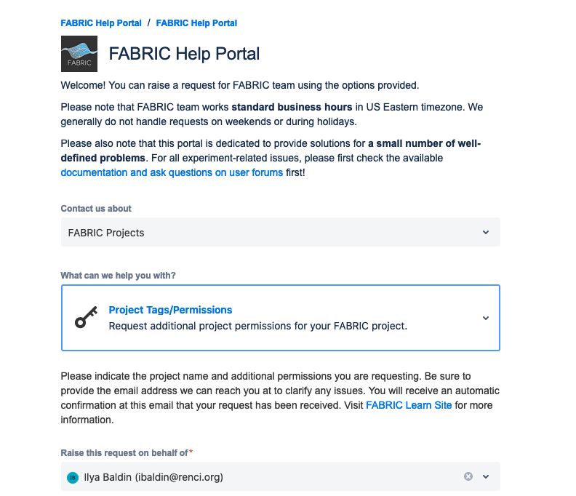
Getting Help
https://learn.fabric-testbed.net - FABRIC Knowledge Base
Documentation articles
API documentation
User forums
Uses federated identity/CI Logon, like everything else in FABRIC
Subscribe to the FABRIC Announcements forum to learn about new features, maintenance events etc.
Use other forums to ask questions about your experiments - someone usually answers within a day (not including weekends)
Help answer questions - it’s your testbed too
There is a small number of specialized topics addressed via Portal (there are contextually placed buttons to do that):
Account problems (logging into Portal, VMs etc) - (‘Contact Us’ in the Portal - doesn’t require logging in)
Requesting to become a Project Lead (under My Roles & Projects)
Requesting additional permissions for your project (Project view)
Requesting specific functionality like persistent storage, peering (Project View)
Click a button, fill out the fields in the form, wait for our response

